Slide 1

Formal Research
Paper Slideshow Infographics
Formal Research Paper Slideshow Infographics
20
23
Here is where this template begins
20
23
Slidesgo

Slide 2
Formal research paper slideshow
This template contains an assortment of supplementary infographic resources for the Formal Research Paper Slideshow presentation.
These infographics are adapted to the style of the aforementioned presentation, so you can insert them easily and have them completely integrated at once. You just need to do the following:
Select the element that you want to copy
Right-click and choose “Copy”
Go to the slide where you want the element to appear
Right-click and choose “Paste”

Slide 3
Formal research paper slideshow
Mars
50%
Mars is full of iron oxide dust, which gives the planet its reddish cast
Mercury
20%
Mercury is the closest planet to the Sun and the smallest one
Venus
30%
Venus has a beautiful name and is the second planet from the Sun

Slide 4
Formal research paper slideshow
50%
20%
30%
10%
Mercury
Venus
Mars
Jupiter
Mercury is a small planet
Venus has a beautiful name
Mars is a very cold place
Jupiter is the biggest planet

Slide 5
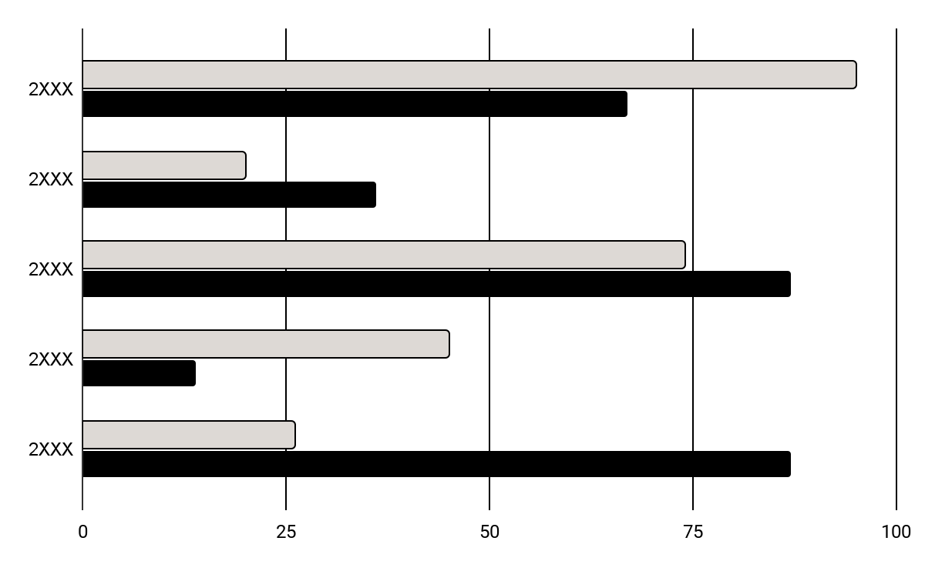
Formal research paper slideshow
Venus
Mercury
It has a beautiful name and is the second planet from the Sun
This planet's name has nothing to do with the liquid metal
Follow the link in the graph to modify its data and then paste the new one here. For more info, click here

Slide 6
Formal research paper slideshow
Venus
Jupiter
Venus is the second planet from the Sun
Jupiter is the biggest planet of them all
01
02
03
04
05
Mercury
Mars
Neptune
It’s the closest planet to the Sun
Despite being red, Mars is actually a cold place
It’s the farthest planet from the Sun

Slide 7
Formal research paper slideshow
2/5
3/5
4/5
Mars
Venus
Mercury
Mars is actually a very cold place
Venus is the second planet from the Sun
Mercury is the closest planet to the Sun
01
02
03

Slide 8
Formal research paper slideshow
A
B
Neptune
Saturn
It’s the farthest planet from the Sun
It’s a gas giant and has several rings
Mars
Mercury
Venus
Jupiter
Despite being red, Mars is cold
It’s the closest planet to the Sun
Venus is the second planet from the Sun
Jupiter is the biggest planet

Slide 9
Formal research paper slideshow
 | Jan | Feb | Mar | Apr
Process 1
Process 2
Process 3
Process 4
Neptune is far away from Earth
Despite being red, Mars is actually a cold place. It's full of iron oxide dust
Neptune is an ice giant
Venus has a beautiful name

Slide 10
Formal research paper slideshow
Venus
Saturn
Venus is the second planet from the Sun
Saturn is a gas giant and has several rings
Research
Mars
Jupiter
Despite being red, Mars is a cold place
It’s the biggest planet in the Solar System

Slide 11
Formal research paper slideshow
Mercury
Venus
This planet's name has nothing to do with the liquid metal, since Mercury was named after the Roman messenger god
It has a beautiful name and is the second planet from the Sun. It’s even hotter than Mercury, and its atmosphere is extremely poisonous

Slide 12
Formal research paper slideshow
Earth
01
Mars
Despite being red, Mars is a very cold place
02
Venus
Venus is the second planet from the Sun
03
Mercury
It’s the closest planet to the Sun
04
Jupiter
Jupiter is the biggest planet of them all

Slide 13
Formal research paper slideshow
Mercury
Saturn
Jupiter
It’s the closest planet to the Sun
It’s a gas giant and has several rings
Jupiter is the biggest planet
Formal research
Mars
Venus
Neptune
Despite being red, Mars is cold
Venus is the second planet from the Sun
It’s the farthest planet from the Sun

Slide 14
Formal research paper slideshow
Action 1
Action 2
Action 3
Action 4
Mercury is very small planet
Saturn is a gas giant with rings
Jupiter is the biggest planet
Mars is full iron oxide dust
Action 8
Action 7
Action 6
Action 5
Despite being red, Mars is cold
Venus is the second planet from the Sun
Neptune is far away from Earth
Earth is the third planet from the Sun

Slide 15
Formal research paper slideshow
Venus
Saturn
Venus is the second planet from the Sun
Saturn is a gas giant and has several rings
Earth
Mars
Jupiter
Despite being red, Mars is a cold place
It’s the biggest planet in the Solar System

Slide 16
Formal research paper slideshow
Mercury
Jupiter
It’s the closest planet to the Sun
Jupiter is the biggest planet of them all
Venus
Saturn
Venus is the second planet from the Sun
It’s a gas giant and has several rings
Mars
Neptune
Despite being red, Mars is cold
It’s the farthest planet from the Sun

Slide 17
Formal research paper slideshow
Research cost | $26,540
Mercury is the closest planet to the Sun and the smallest of them all | $1,040
Venus has a beautiful name and is the second planet from the Sun | $12,500
Jupiter is a gas giant and the biggest planet in the Solar System | $3,000
Earth is the third planet from the Sun and the only one that harbors life | $10,000

Slide 18
Formal research paper slideshow
01
Mars
Despite being red, Mars is cold
02
Venus
Venus is the second planet from the Sun
Research
03
Mercury
It’s the closest planet to the Sun
04
Jupiter
Jupiter is the biggest planet of them all

Slide 19
Formal research paper slideshow
Objective
Mercury
Action 2
Mercury is the closest planet to the Sun
Saturn is a gas giant and has several rings
01
02
03
04
Mars
Venus
Neptune
Earth
Despite being red, Mars is cold
Venus is the second planet from the Sun
Neptune is far away from Earth
Earth is the third planet from the Sun

Slide 20
Formal research paper slideshow
Questions
Notes
Earth is the only planet known to harbor life
Mars is full of iron oxide dust
Jupiter doesn’t have a solid surface
Saturn is the ringed planet
Neptune is very far away from the Sun
01
Despite being red, Mars is actually a cold place. It's full of iron oxide dust
02
Venus has a beautiful name and is the second planet from the Sun
Summary
Venus is terribly hot, even hotter than Mercury, and its atmosphere is extremely poisonous. It’s the second-brightest natural object in the night sky after the Moon
03
Mercury is the closest planet to the Sun and the smallest one

Slide 21
Formal research paper slideshow
Venus
80%
Venus is the second planet from the Sun
Mars
20%
Despite being red, Mars is a cold place

Slide 22
Formal research paper slideshow
Mercury
It’s the closest planet to the Sun
Formal research
Venus
Mars
Venus is the second planet from the Sun
Despite being red, Mars is cold

Slide 23
Formal research paper slideshow
50%
20%
30%
Venus
Mercury
Mars
Venus is the second planet from the Sun
It’s the closest planet to the Sun
Despite being red, Mars is cold
Note
This planet's name has nothing to do with the liquid metal, since Mercury was named after the Roman messenger god. Despite being closer to the Sun than Venus, its temperatures aren't as terribly hot as that planet's. Its surface is quite similar to that of Earth's Moon

Slide 24
Formal research paper slideshow
Date | Research | Description
xx/xx/xx | Jupiter | Jupiter is a gas giant and the biggest planet in the Solar System
xx/xx/xx | Earth | Earth is the third planet from the Sun and the only one that harbors life
xx/xx/xx | Mercury | Mercury is the closest planet to the Sun and the smallest of them all
xx/xx/xx | Venus | Venus has a beautiful name and is the second planet from the Sun

Slide 25
Formal research paper slideshow
Neptune
Saturn
Mars
Mercury
You can write here
You can write here
You can write here
You can write here
You can write here
You can write here
You can write here
You can write here
You can write here
You can write here
You can write here
You can write here
You can write here
You can write here
You can write here
You can write here
You can write here
You can write here
You can write here
You can write here
You can write here
You can write here
You can write here
You can write here

Slide 26
Formal research paper slideshow
Then
Now
Mercury is the closest planet to the Sun
Action 1
Jupiter is the biggest planet of them all
Venus is the second planet from the Sun
Action 2
Saturn is a gas giant and has several rings
Despite being red, Mars is cold
Action 3
Neptune is far away from Earth

Slide 27
Formal research paper slideshow
1/5
4/5
3/5
2/5
Mercury
Jupiter
Mercury is the closest planet to the Sun and the smallest one
Jupiter is a gas giant and the biggest planet in the Solar System
Ceres is located in the main asteroid belt
Saturn is a gas giant and has several rings
Neptune is the farthest planet from the Sun
The Sun is the star at the center of the Solar System
Saturn
Venus
Mars
Neptune

Slide 28
Formal research paper slideshow
 | Mars | Mercury | Venus | Neptune
Action 1 | Yes | No | Yes | No
Action 2 | No | Yes | No | Yes
Action 3 | Yes | No | Yes | No
Action 4 | No | Yes | No | Yes
Action 5 | Yes | No | Yes | No
Action 6 | No | Yes | No | Yes

Slide 29
Formal research paper slideshow
Objectives
Saturn
Jupiter
Saturn is a gas giant and has several rings
It's composed mostly of hydrogen and helium
It was named after the Roman god of wealth and agriculture
Jupiter is a gas giant and the biggest planet
It's the fourth-brightest object in the night sky
It was named after the Roman god of the skies and lightning

Slide 30
Formal research paper slideshow
Theory | Description
Theory 01 | Jupiter is the biggest planet of them all Jupiter is big
Theory 02 | Despite being red, Mars is actually a cold place Mars is made of basalt
Theory 03 | Venus has a toxic atmosphere Venus has extremely high temperatures
Theory 04 | Earth is also known as the Blue Planet Earth is the planet with life

Slide 31
Formal research paper slideshow
Research
Jupiter is the biggest planet of them all
Venus
Mercury
Mars
Venus is the second planet from the Sun
It’s the closest planet to the Sun
Despite being red, Mars is cold

Slide 32
Formal research paper slideshow
Positive conclusions
Mercury is the closest planet to the Sun
Venus has a beautiful name
Jupiter is a gas giant and the biggest planet
Neptune is the farthest planet from the Sun
Negative conclusions
The Moon is Earth’s only natural satellite
Saturn is a gas giant and has several rings
Pluto is now considered a dwarf planet
Mars is actually a cold place

Slide 33
Instructions for use
If you have a free account, in order to use this template, you must credit Slidesgo in your final presentation. Please refer to the next slide to read the instructions for premium users.
As a Free user, you are allowed to:
- Modify this template.
- Use it for both personal and commercial projects.
You are not allowed to:
- Sublicense, sell or rent any of Slidesgo Content (or a modified version of Slidesgo Content).
- Distribute Slidesgo Content unless it has been expressly authorized by Slidesgo.
- Include Slidesgo Content in an online or offline database or file.
- Offer Slidesgo templates (or modified versions of Slidesgo templates) for download.
- Acquire the copyright of Slidesgo Content.
For more information about editing slides, please read our FAQs or visit our blog:
https://slidesgo.com/faqs and https://slidesgo.com/slidesgo-school

Slide 34
Instructions for use (premium users)
As a Premium user, you can use this template without attributing Slidesgo.
You are allowed to:
Modify this template.
Use it for both personal and commercial purposes.
Share this template in an editable format with people who are not part of your team.
You are not allowed to:
Sublicense, sell or rent this Slidesgo Template (or a modified version of this Slidesgo Template).
Distribute this Slidesgo Template (or a modified version of this Slidesgo Template) or include it in a database or in any other product or service that offers downloadable images, icons or presentations that may be subject to distribution or resale.
Use any of the elements that are part of this Slidesgo Template in an isolated and separated way from this Template.
Register any of the elements that are part of this template as a trademark or logo, or register it as a work in an intellectual property registry or similar.
For more information about editing slides, please read our FAQs or visit our blog:
https://slidesgo.com/faqs and https://slidesgo.com/slidesgo-school

Slide 35
Infographics
You can add and edit some infographics to your presentation to present your data in a visual way.
Choose your favourite infographic and insert it in your presentation using Ctrl C + Ctrl V or Cmd C + Cmd V in Mac.
Select one of the parts and ungroup it by right-clicking and choosing “Ungroup”.
Change the color by clicking on the paint bucket.
Then resize the element by clicking and dragging one of the square-shaped points of its bounding box (the cursor should look like a double-headed arrow). Remember to hold Shift while dragging to keep the proportions.
Group the elements again by selecting them, right-clicking and choosing “Group”.
Repeat the steps above with the other parts and when you’re done editing, copy the end result and paste it into your presentation.
Remember to choose the “Keep source formatting” option so that it keeps the design. For more info, please visit our blog.

